Slide 1
Fungal Diseases of Paranasal Sinuses

Slide 2
Classification
Non invasive fungal rhinosinusitis.
Allergic fungal rhinosinusitis
Mycetoma
Invasive fungal rhinosinusitis
Acute invasive
Chronic invasive
Granulomatous

Slide 3
Non-invasive fungal rhinosinusitis

Slide 4
Allergic fungal rhinosinusitis
Most common form FRS.
Characterized by dark thick, inspissated mucus filling PNS.
On M/E necrotic and degraanulating eosinophils, charcot leyden crystals & few fungal hyphae
Most common organisms isolated are bipolaris and curvularia fungi

Slide 6
Clinical Manifestations
Classically unilateral disease
Slow progressive nasal congestion
PND
Nasal obstruction
Anosmia
Thick mucinous debris in nasal discharge

Slide 7
Patients are typically young, atopic and immunocompetent.
The patients may have unilateral or bilateral nasal polyposis and thick yellow to green colored nasal discharge.
CT Scan demonstrates opacification of multiple sinuses, mucoceles and bone remodelling.

Slide 8
The hyperdensity is due to one or a combination of the following:
Inspissated secretions, fungus or blood

Slide 9
Treatment
AFRS is treated through a combination of medical and surgical methods.
Surgery is employed to open and evacuate PNS
Immunotherapy
Leukotrine inhibitors
Systemic steroids
Macrolides
Anti-fungals

Slide 10
Mycetoma
Classically described in immunocompetent persons
It is a non-invasive fungal infection.
The most frequently isolated organism is Aspergillosis fumigatus.

Slide 11
The patients present with old symptoms of:
Nasal obstruction
Unilateral purulent nasal discharge
Cacosmia
Seldom proptosis.
In most patients only one sinus (maxillary sinus) is implicated
The mycetoma grows in the sinus exerting mass effect

Slide 12
Radiological findings include partial or complete opacification of the sinus, thickening of bony walls and sclerosis or bone destruction.
CT scan of the sinus reveals opacification of the involved sinus with flocculent calcifications.
The diagnostics points on histopathology are collection of dense, matted fungal hyphae that are lying separate from mucosa.

Slide 13
Mycetoma

Slide 14
Treatment
The “typical peanut butter” appearance of the mycetoma is seen when opening involved area.
Opening the sinus and removal of all the debris is mainstay of treatment.
Medical therapy is generally not needed.

Slide 16
Invasive fungal rhinosinusitis

Slide 17
A life threatening disorder
Fungi invade sinus mucosa, bone, adjacent structures such as eyes or brain.
Several organisms have been shown to be causative organisms for the different forms.
Most often the causative organisms are Asmycota phylum, Aspergillus species and Mucorales.
Different species may coexist.

Slide 18
Patients at risk are immunocompromised with the exception of chronic granulomatous form.
Common immunodeficiency-associated risk factors include:
Diabetes,
AIDS,
Hematologic malignancies with leukopenia, leukopenia for other reasons
Immunomodulation for organ transplant.

Slide 19
Patients who are immunocompromised and present with signs of rhinosinusitis should be examined with nasal endoscopy.
Sloughing, crusting, necrosis or hypovascular areas should raise the suspicion for fungal sinusitis.

Slide 20
Patients may present with
Epistaxis
Infection of facial soft tissues
Peri-orbital oedema
Proptosis
Decreased vision
Mental status change
Seizures

Slide 21
Mortality depends on several factors:
Form of disease
Extent of involvement
Use of combination surgical and medical therapy
Patient immune factors

Slide 22
Acute Invasive Fungal Rhinosinusitis
Acute form is present for less than four weeks.
It progresses rapidly, can manifest within hours.
It may prove fatal in 50-80% patients.
Therefore it should be considered an emergency.
Tissue involvement can spread rapidly from sinuses to adjacent tissues.
Most commonly caused by Aspergillus fumigatus

Slide 25
Treatment
Treatment is both medical and surgical.
Surgical debridement
This may involve radical excision of tissues including removal of orbital contents, overlying soft tissues of face and some involved intracranial tissues.

Slide 26
Medical Treatment
Two forms
Anti-fungal therapy
Therapy against underlying immunocompromise.
Aspergillus fusiform: Voriconazole
Candid: Fluconazole
For neutropenic patients: Amphotericin B
No agent identified: Amphotericin B

Slide 27
Chronic Invasive Fungal Rhinosinusitis
It is a slowly progressive disease.
It is seen both in immuno-competent and immuno-compromised patients.
The disorder is usually caused by aspergillus.
The condition begins as a fungal ball and then becomes invasive perhaps as a result of immuno-suppression.
It has a low degree of invasion.

Slide 28
The patients present with previous symptoms of Nasal obstruction
Unilateral facial discomfort
An enlarging mass or silent proptosis.
CT findings show a hyper dense mass with associated erosion of sinus walls.

Slide 29
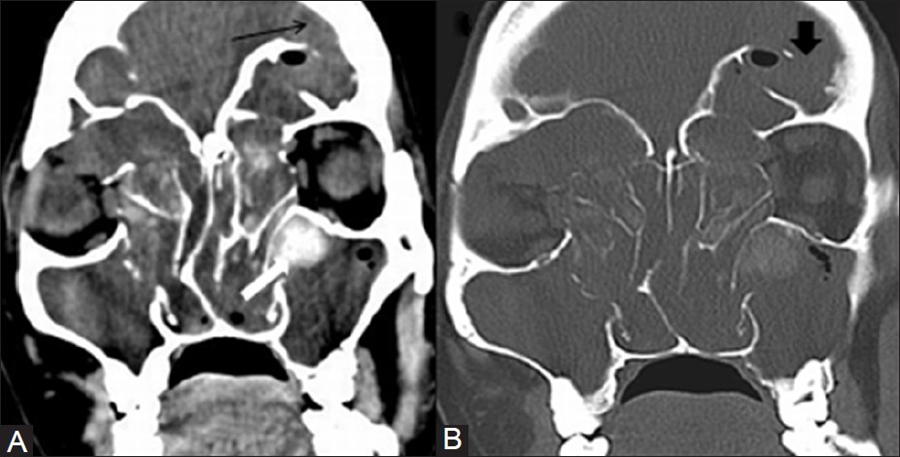

Slide 30
Treatment
Initiate medical treatment with systemic antifungals once invasion is diagnosed. Amphotericin B (2 g/d) is recommended.
This can be replaced by ketoconazole or itraconazole once the disease is under control.
Surgical treatment is mandatory and can be approached endoscopically in some patients.
Consider an external approach when adequate debridement cannot be achieved endoscopically.

